Slide 1

A Comparative study of Data-Augmentation Techniques for Imbalanced Hate Speech Data
DhyanKumar Shah (1131707)
Shruti Govani (1143388)

Slide 2
Problem Statement
01
In recent era, social media and microblogging apps are a golden tools for bringing people together and allowing them to network, share information, and express their personal viewpoints.
However, During discussions and debates, fights take place on social media platforms and that contains rude, disrespectful and hateful comments known as toxic comments or hateful speech.
These toxic comments and posts contain a variety of risks, including fake news, cyberbullies and online harassment which leads to various psychological issues for users, such as depression, frustration, and even suicidal thoughts. And thus, it needs to be controlled.
As, this toxic data can’t manually censor, deleted, or controlled and thus we need a framework that can detect such data and might prevent publishing.

Slide 3
Introduction
02
Hate speech is described as any form of communication that is abusive, insulting, intimidating, and/or in- cites violence or prejudice against an individual or a vulnerable group based on characteristics such as ethnicity, gender, sexual orientation, or religion.
Several techniques and approaches have been introduced for an automatic detection of such contents using Artificial Intelligence and Natural language processing.
However, Text classification, on the other hand, has a lot of data imbalance problems. The problem of an unbalanced dataset occurs when data from one class is considerably greater or lower than data from other classes.
Data augmentation is a technique that can help generate a large amount of data from a small amount.
Here, we are going to experiment with various data augmentation techniques such as Generative adversarial network (GAN), synthetic minority oversampling technique (SMOTE), Never Miss to analyze the performance of proposed approach.

Slide 4
Literature Review
Title | Name of Journal | Year | Link | Model Used | Conclusion/Results
Augment to Prevent: Short-Text Data Augmentation in Deep Learning for Hate-Speech Classification | 28th ACM International Conference on Information and Knowledge Management | 2019 | Link | CNN + GRU GloVe + CNN + Dense | They propose three text-based data augmentation techniques a) Synonym replacement b) Warping of the word tokens along the padded sequence c) Class-conditional, recurrent neural language generation
A Survey on Data Augmentation for Text Classification | German Federal Ministry of Education and Research (BMBF) | 2021 | Link | Data Augmentation Techniques | Based on a precise description of the goals and applications of data augmentation (C1) and a taxonomy for existing works (C2), this survey is concerned with data augmentation methods for textual classification and aims to achieve a concise and comprehensive overview for researchers and practitioners
Multimodal Hate Speech Detection in Greek Social Media | Multimodal Technologies and Interaction | 2021 | Link | BERT, RESNET | In racist and xenophobic speech detection (Accuracy score = 0.970, F1-score = 0.947)

Slide 5
Literature Review
Title | Name of Journal | Year | Link | Model Used | Conclusion/Results
Impact of Smote on Imbalanced Text Features for Toxic Comments Classification Using RVCC Model | IEEE Access | 2021 | Link | RVCC Model | This study introduces an ensemble approach, called regression vector voting classifier (RVVC). For data balance, the synthetic minority oversampling technique (SMOTE) is used on the imbalanced dataset. Furthermore, two feature extraction approaches are utilized to investigate their suitability such as TF-IDF and BOW. Results suggest that RVVC outperforms all other individual models and achieves 0.97 accuracy.
Data Augmentation for Sentiment Analysis Using Sentence Compression-Based SeqGAN With Data Screening | IEEE Access | 2021 | Link | SeqGAN | In this paper, data augmentation framework that combines supervised learning sentence compression, SeqGAN, and data screening was proposed. After using the proposed sentence compression, the usability is improved by 24.6%, and the novelty is improved by 4.8% on average. The diversity of the generated data of the proposed framework is improved by an average of 58.4% compared with the conventional method EDA.

Slide 6
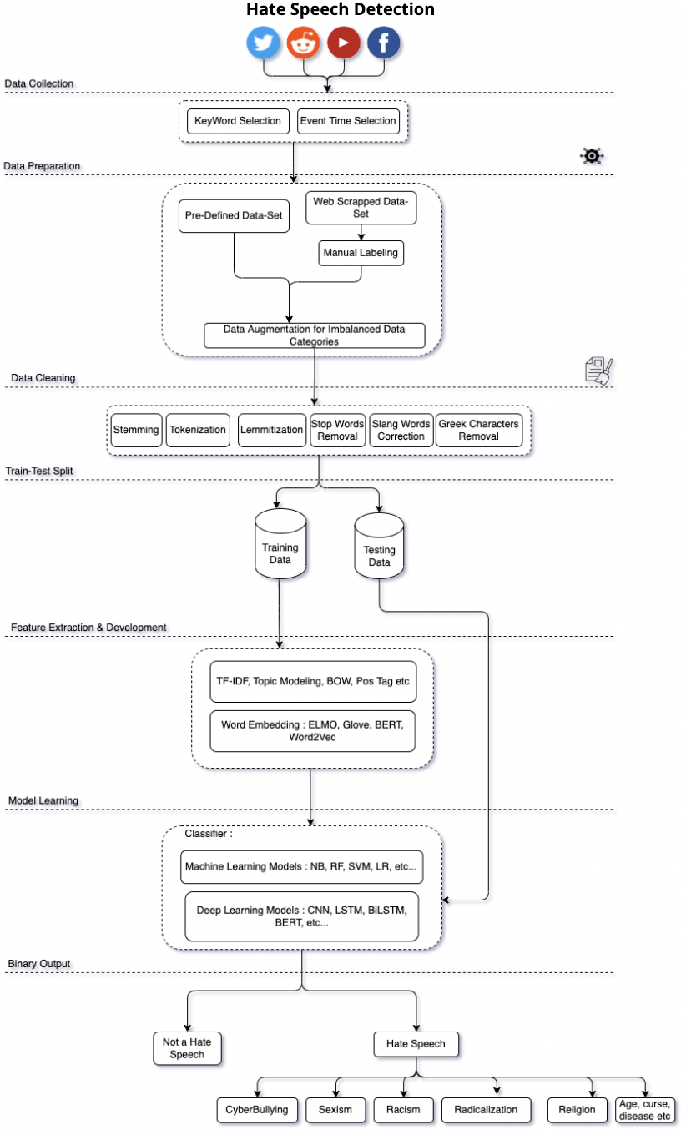
Data Pipeline

Slide 7
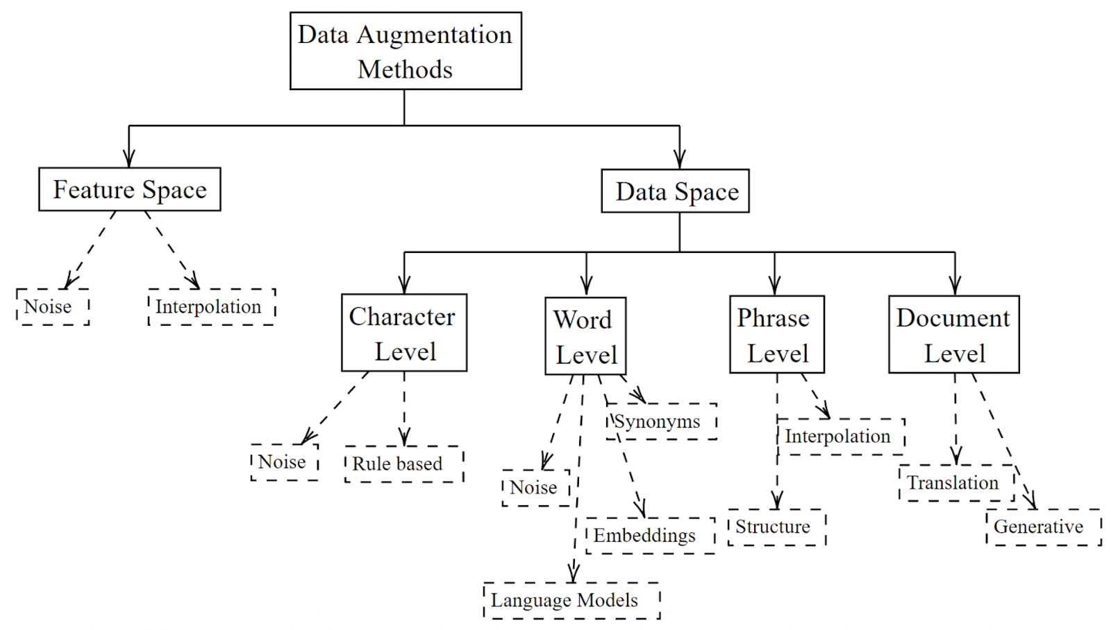
Methodologies
03
Data Augmentation Techniques
Word Level
Document Level

Slide 8
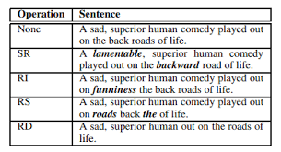
Word Level
04
Synonym Replacement (SR): Pick n words from the phrase that aren’t stop words at random. Each of these words should be replaced with a synonym picked at random.
Random Insertion (RI): Identifying and extracting synonyms for certain randomly picked words in the phrase that are not Stop-Words. Using this determined synonym in a phrase at a random location.
Random Swap (RS): Randomly choosing two words in the sentence and swap their positions.
Random Deletion (RD): Randomly removing word in the sentence

Slide 9
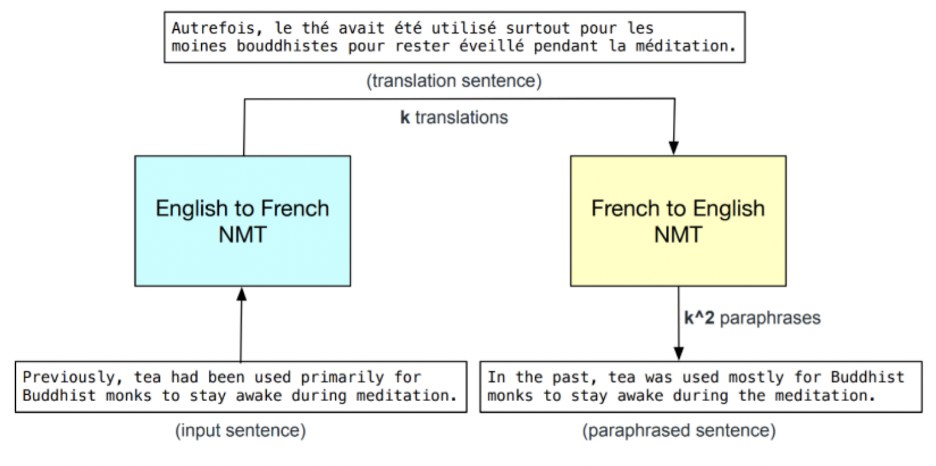
Document Level
05
Translation Model :
Round-trip translation is a method of obtaining paraphrases using translation models. A word, phrase, sentence, or document is translated into another language (forward translation) and then back to the original language (reverse translation) (back translation)
Because of its intrinsic label preservation and very important paraphrase capabilities, the technique seems promising.
Generative Model :
In recent data augmentation research, generative approaches have gotten a lot of attention. As language generation capabilities have improved, models are now capable of producing a wide range of texts and may therefore integrate new information.

Slide 10
Thank You!

